Slide 1
Complex Differentiation and The Cauchy-Riemann Equation
Lecture-11

Slide 2
This Lecture Covers-
1. Definition of Analytic function
2. Necessary condition for a function to be analytic.
3. Cauchy-Riemann equations.
4. Some Examples and Exercises based on discussion in this lecture.
5. Sample Multiple Choice Questions (MCQs)

Slide 3



Euler’s Formulae on complex number:
$$e^{iθ}=\cos{θ+i\sin{θ}}$$
And $e^{−iθ}=\cos{θ−i\sin{θ}}$
Some Important Formulae:
$$\sin{at}=\frac{e^{iat}−e^{−iat}}{2i}$$
$$\cos{at}=\frac{e^{iat}+e^{−iat}}{2}$$
$$\sinh{at}=\frac{e^{at}−e^{−at}}{2}$$
$$\cosh{at}=\frac{e^{at}+e^{−iat}}{2}$$
$\cos{iay}=\cosh{ay}$; $−i\sin{iay}=\sinh{ay}$

Slide 4




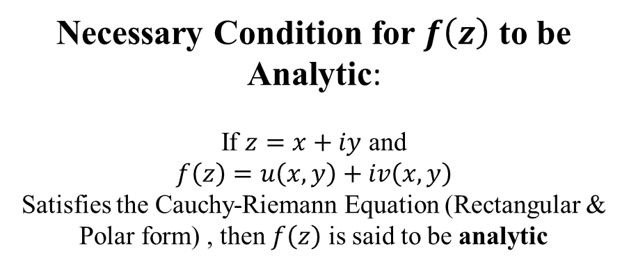
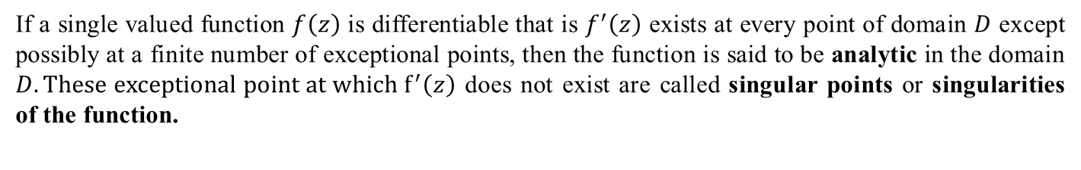
If a single valued function $f\left(z\right)$ is differentiable that is $f^{′}\left(z\right)$ exists at every point of domain $D$ except possibly at a finite number of exceptional points, then the function is said to be analytic in the domain $D. These exceptional point at which f^{′}\left(z\right)$ does not exist are called singular points or singularities of the function.
Analytic Function
$$f^{′}\left(z\right)=u_{x}+iv_{x}$$
Necessary Condition for $f\left(z\right)$ to be Analytic:
If $z=x+iy$ and
$$f\left(z\right)=u\left(x,y\right)+iv\left(x,y\right)$$
Satisfies the Cauchy-Riemann Equation (Rectangular & Polar form) , then $f\left(z\right)$ is said to be analytic
Polar Form
$$\frac{∂u}{∂r}=\frac{1}{r}\frac{∂v}{∂θ}$$
and
$$\frac{∂v}{∂r}=−\frac{1}{r}\frac{∂u}{∂θ}$$
Rectangular Form
$$\frac{∂u}{∂x}=\frac{∂v}{∂y}$$
and
$$\frac{∂u}{∂y}=−\frac{∂v}{∂x}$$
$$f^{′}\left(z\right)={e^{−iθ}(u}_{r}+iv_{r})$$

Slide 5





Examples
For the function $f\left(z\right)=z^{2}$
(a) Separate real and imaginary parts
(b) Verify C-R equations.
(c) find $f^{′}\left(z\right)$ using $u_{x}+i v_{x}$
We must show that
$\frac{∂u}{∂x}=\frac{∂v}{∂y}$ and$\frac{∂u}{∂y}=−\frac{∂v}{∂x}$
$\frac{∂u}{∂x}$= $\frac{∂}{∂x}\left(x^{2}−y^{2}\right)=2x$
$\frac{∂v}{∂y}$= $\frac{∂}{∂y}\left(2xy\right)=2x$
So,$\frac{∂u}{∂x}$= $\frac{∂v}{∂y}$
$\frac{∂u}{∂y}$= $\frac{∂}{∂y}\left(x^{2}−y^{2}\right)=−2y$
$\frac{∂v}{∂x}$= $\frac{∂}{∂x}\left(2xy\right)=2y$
So,$\frac{∂u}{∂y}$= $−\frac{∂v}{∂x}$
We know,
$$f^{′}\left(z\right)=u_{x}+iv_{x}$$
$$u_{x}=\frac{∂u}{∂x}=2x$$
$$v_{x}=\frac{∂v}{∂x}=2y$$
So, $f^{′}\left(z\right)=u_{x}+iv_{x}$ $$=2x+i. 2y \\ =2\left(x+iy\right) \\ =2z$$
Given, $f\left(z\right)=z^{2}$
$$⇒u+iv={\left(x+iy\right)}^{2}$$
$$⇒u+iv=x^{2}+2.x.iy+{\left(iy\right)}^{2}$$
$$⇒u+iv=x^{2}+i.2xy+i^{2}y^{2}$$
$$⇒u+iv=x^{2}+i.2xy−y^{2} \left[∵i^{2}=−1\right]$$
$$⇒u+iv=\left(x^{2}−y^{2}\right)+i.\left(2xy\right)$$
Comparing both sides
Real part, $u=x^{2}−y^{2}$
Imaginary part, $v=2xy$

Slide 6





Examples
For the function $f\left(z\right)=z{+e}^{2z}$
(a) Separate real and imaginary parts
(b) Verify C-R equations.
(c) find $f^{′}\left(z\right)$ using $u_{x}+i v_{x}$
Given, $f\left(z\right)=z{+e}^{2z}$
$$⇒u+iv={\left(x+iy\right)+e}^{2(x+iy)}$$
$$⇒u+iv =\left(x+iy\right){{+e}^{2x}e}^{2iy}$$
$⇒u+iv$ $=\left(x+iy\right){+e}^{2x}(\cos{2y}+i\sin{2y})$
$⇒u+iv$ $=({x+e}^{2x}\cos{2y})+i(y{+e}^{2x}\sin{2y})$
Comparing both sides
Real part, $u={x+e}^{2x}\cos{2y}$
Imaginary part, $v=y{+e}^{2x}\sin{2y}$
We must show that
$u_{x}=v_{y}$ and$u_{y}=−v_{x}$
$u_{x}=$ $\frac{∂}{∂x}\left({x+e}^{2x}\cos{2y}\right)$
$$={1+2e}^{2x}\cos{2y}$$
$v_{y}=$ $\frac{∂}{∂y}\left(y{+e}^{2x}\sin{2y}\right)$
$$=1+2e^{2x}\cos{2y}$$
So, $u_{x}=v_{y}$
$u_{y}=$ $\frac{∂}{∂y}\left({x+e}^{2x}\cos{2y}\right)$
$$=−2e^{2x}\sin{2y}$$
$v_{x}=$ $\frac{∂}{∂x}\left(y{+e}^{2x}\sin{2y}\right)$
$$=2e^{2x}\sin{2y}$$
So, $u_{y}=−v_{x}$.
We know,
$$f^{′}\left(z\right)=u_{x}+iv_{x}$$
$$u_{x}={1+2e}^{2x}\cos{2y}$$
$$v_{x}=2e^{2x}\sin{2y}$$
So, $f^{′}\left(z\right)=u_{x}+iv_{x}$
$$={1+2e}^{2x}\cos{2y}+i2e^{2x}\sin{2y} \\ =1+2e^{2x}\left(\cos{2y}+i\sin{2y}\right) \\ =1+2e^{2x}e^{i2y}$$
$$=1+2e^{2x+i2y}$$
$$=1+2e^{2(x+iy)}$$
$$=1+2e^{2z}$$

Slide 7





Examples
For the function $f\left(z\right)=\frac{1}{z^{3}}$
(a) Separate real and imaginary parts
(b) Verify C-R equations.
(c) find $f^{′}\left(z\right)$ using $e^{−iθ}\left(u_{r}+iv_{r}\right)$
Given, $f\left(z\right)=\frac{1}{z^{3}}$
$$⇒u+iv=\frac{1}{{\left(re^{iθ}\right)}^{3}}$$
$$⇒u+iv=\frac{1}{r^{3}e^{i.3θ}}$$
$$⇒u+iv=\frac{1}{r^{3}}e^{−i. 3θ}$$
$$⇒u+iv=\frac{1}{r^{3}}\left(\cos{3θ−i\sin{3θ}}\right)$$
$$⇒u+iv=\frac{1}{r^{3}}\cos{3θ}+i.\left(−\frac{1}{r^{3}}\sin{3θ}\right)$$
Comparing both sides
Real part, $u=\frac{1}{r^{3}}\cos{3θ}$
Imaginary part, $v=−\frac{1}{r^{3}}\sin{3θ}$
We must show that
$\frac{∂u}{∂r}=\frac{1}{r}\frac{∂v}{∂θ}$ and$\frac{∂v}{∂r}=−\frac{1}{r}\frac{∂u}{∂θ}$
$\frac{∂u}{∂r}$= $\frac{∂}{∂r}\left(\frac{1}{r^{3}}\cos{3θ}\right)=−3\frac{1}{r^{4}}\cos{3θ}$
$\frac{∂v}{∂θ}$= $\frac{∂}{∂θ}\left(−\frac{1}{r^{3}}\sin{3θ}\right)=−\frac{3}{r^{3}}\cos{3θ}$
So,$\frac{∂u}{∂r}=$ $\frac{1}{r}\frac{∂v}{∂θ}$
$\frac{∂v}{∂r}$= $\frac{∂}{∂r}\left(−\frac{1}{r^{3}}\sin{3θ}\right)=3\frac{1}{r^{4}}\sin{3θ}$
$\frac{∂u}{∂θ}$= $\frac{∂}{∂θ}\left(\frac{1}{r^{3}}\cos{3θ}\right)=−\frac{3}{r^{3}}\sin{3θ}$
So,$\frac{∂v}{∂r}$ = $−\frac{1}{r}\frac{∂u}{∂θ}$
We know,
$$f^{′}\left(z\right)=e^{−iθ}\left(u_{r}+iv_{r}\right)$$
$$u_{r}=\frac{∂u}{∂r}=−\frac{3}{r^{4}}\cos{3θ}$$
$$v_{r}=\frac{∂v}{∂r}=\frac{3}{r^{4}}\sin{3θ}$$
So, $f^{′}\left(z\right)=e^{−iθ}\left(u_{r}+iv_{r}\right)$ $$=e^{−iθ}\left(−\frac{3}{r^{4}}\right)\left(\cos{3θ−i\sin{3θ}}\right) \\ =−\frac{3}{r^{4}e^{i4θ}}=−3\frac{1}{{\left(r e^{iθ}\right)}^{4}}=−\frac{3}{z^{4}}$$

Slide 8
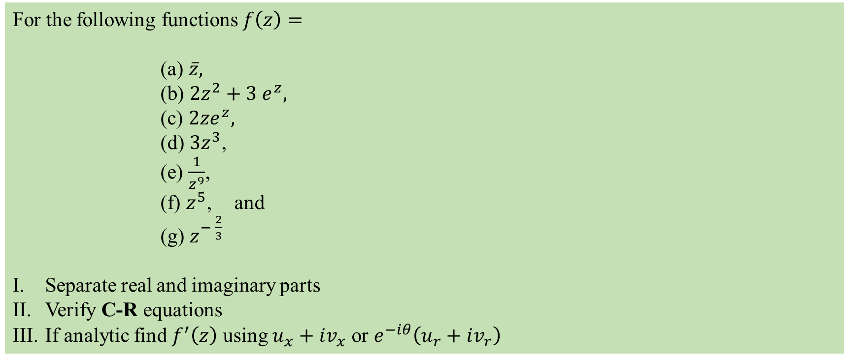
Exercise Set
For the following functions $f\left(z\right)=$
(a) $\overline{z},$
(b) $2z^{2}+3 e^{z},$
(c) $2ze^{z},$
(d) $3z^{3}$,
(e) $\frac{1}{z^{9}}$,
(f) $z^{5}$, and
(g) $z^{− \frac{2}{3}}$
Separate real and imaginary parts
Verify C-R equations
If analytic find $f^{′}\left(z\right)$ using $u_{x}+iv_{x}$ or $e^{−iθ}\left(u_{r}+iv_{r}\right)$

Slide 9




















Sample MCQ
1. What is the real part of $f\left(z\right)=e^{z^{2}}?$
(a) $x^{2}−y^{2}$
(b) $e^{x^{2}+y^{2}}\left(\cos{2xy}\right)$
(c) $e^{x^{2}−y^{2}}\left(\cos{2xy}\right)$
(d) $e^{x^{2}−y^{2}}\left(\sin{2xy}\right)$
2. For $f\left(z\right)=\ln{z}$, which of the following is the real part? (Solution)
(a) $x^{2}+y^{2}$
(b) $\frac{1}{2}\left(x^{2}+y^{2}\right)$
(c) $\ln\left(x^{2}+y^{2}\right)$
€z
(d) $\frac{1}{2}\ln\left(x^{2}+y^{2}\right)$
3. For $f\left(z\right)=\ln{z}$, which of the following is the imaginary part? (Solution)
(a) $\frac{y}{x}$
€z
(b) $\tan^{−1}\left(\frac{y}{x}\right)$
(c) $xy$
(d) $\sin^{−1}\left(\sqrt{x^{2}+y^{2}}\right)$
4. For $u+iv=\sin{z,}$ which of the following is $u_{x}$ ? (Solution)
€z
(a) $\cos{x\cosh{y}}$
(b) $\sin{x\cosh{y}}$
(c) $\sin{x}$
(d) $\sinh{y}$
5. For $u+iv=z^{3}$ which of the following is $v_{y}$?
(a) $x^{2}+y^{2}$
€z
(b) $3x^{2}−3y^{2}$
(c) $x^{2}−y^{2}$
(d) $2x^{2}−2y^{2}$

Slide 10

Solution of MCQ no 2 and 3
$$\ln{z}$$
$$=\ln\left(re^{iθ}\right)$$
$$=\ln{r+\ln{e^{iθ}}}$$
$$=\ln{r+iθ\ln{e}}$$
$$=\ln\left(\sqrt{x^{2}+y^{2}}\right)+i\tan^{−1}\left(\frac{y}{x}\right)$$
So, Real part is
$$\ln\left(\sqrt{x^{2}+y^{2}}\right)$$
$$=\ln{{\left(x^{2}+y^{2}\right)}^{\frac{1}{2}}}$$
$$=\frac{1}{2}\ln\left(x^{2}+y^{2}\right)$$
And imaginary part is
$$\tan^{−1}\left(\frac{y}{x}\right)$$
[Back to Current Slide]

Slide 11
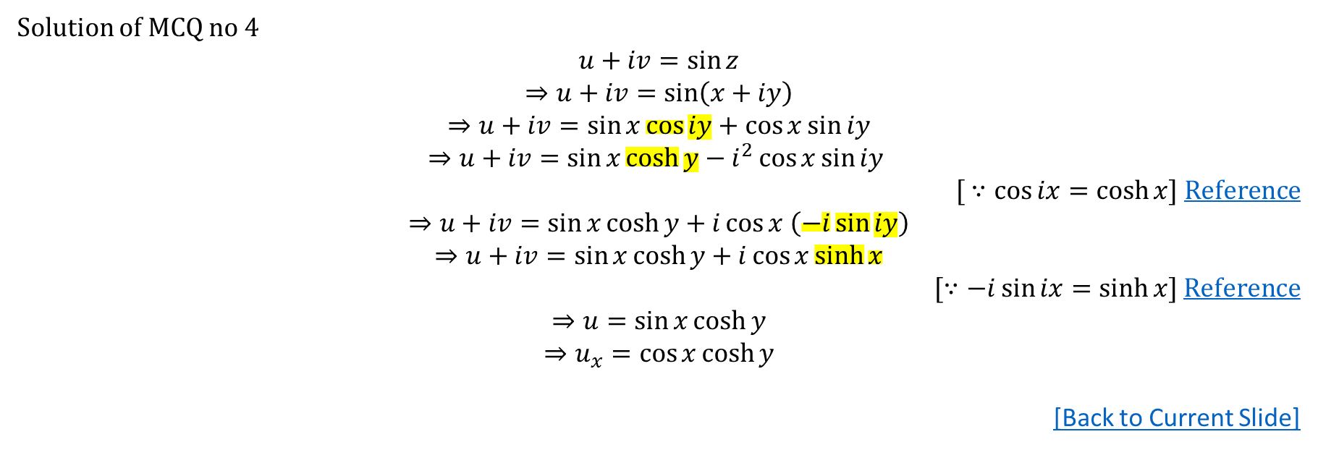
Solution of MCQ no 4
$$u+iv=\sin{z}$$
$$⇒u+iv=\sin\left(x+iy\right)$$
$$⇒u+iv=\sin{x\cos{iy}}+\cos{x\sin{iy}}$$
$$⇒u+iv=\sin{x\cosh{y}}−i^{2}\cos{x\sin{iy }}$$
[ $∵\cos{ix=\cosh{x]}}$ Reference
$$⇒u+iv=\sin{x\cosh{y+i\cos{x \left(−i\sin{iy}\right)}}}$$
$$⇒u+iv=\sin{x\cosh{y+i\cos{x\sinh{x}}}}$$
[$∵−i\sin{ix=\sinh{x}}$] Reference
$$⇒u=\sin{x\cosh{y}}$$
$$⇒u_{x}=\cos{x\cosh{y}}$$
[Back to Current Slide]

